Slide 1
A new restaurant in Florence

Slide 2
We have been demanded from a famous chain restaurant to locate the best area in Florence to open a new venue and we have been given instructions
Main customers are families and people between the age of 12 and 45
Areas with less restaurants are better
Close bus/train station are valuable

Slide 3
Data acquisition and transformation
Data were gathered from different sources. Particularly:
District location data: retrieved from Google Maps
Population by District and Age data: scraped from www.opendata.comune.fi.it
Family Number by District and Age data: scraped from www.opendata.comune.fi.it

Slide 4
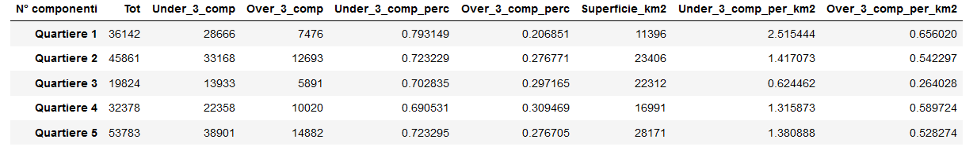
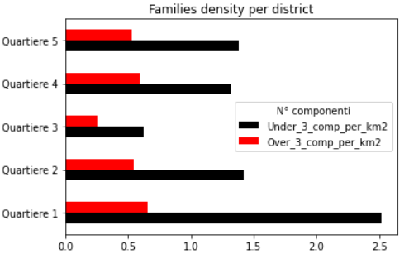
In each district the majority of family unites is composed of 1 or at least 2 people
Quartiere 1 has a huge concentration of this kind of households
Quartiere 3 shows a general low density of families

Slide 5
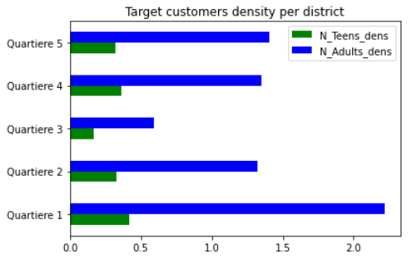
Similar situation for density of target customer per district.
Areas that differ from other are Quartiere 1 and Quartiere 3

Slide 6
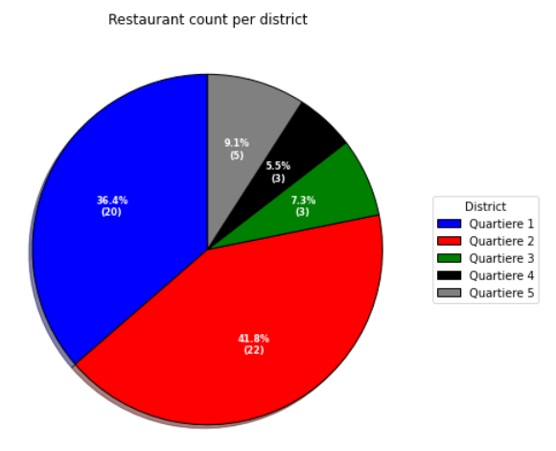
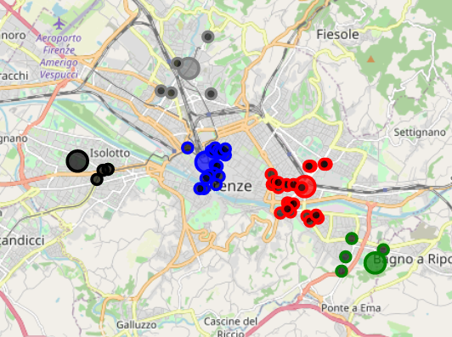

Slide 7
Conclusions
Quartiere 3 discarded due to dispersity
Quartiere 1 seemed a good choice considering the great amount of people in target and families, however the huge presence of other restaurants in this area makes competition a real problem; a similar thought was made for Quartiere 2
Quartiere 4 was chosen over Quartiere 5 because of the slight difference in families and teens density; moreover, there are 2 light rail station close to the spot located (under 1 km), which are valuable.

